Slide 1
Cost Benefit Evaluation techniques
Name-Vaibhav Gupta Branch- CSE-MI Roll No.-17

Slide 2
Cost Benefit Evaluation techniques
Net profit
Payback Period
Return on investment or Accounting Rate of Return
Net present Value
Internal rate of return

Slide 3
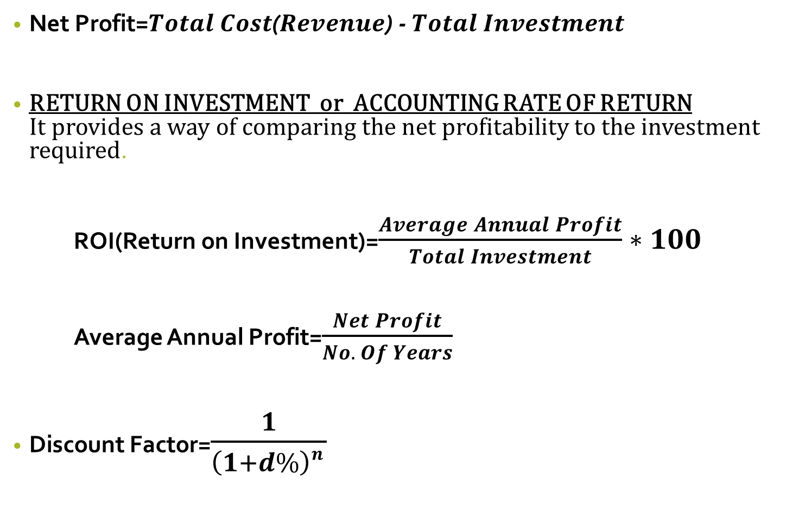
Net Profit=$Total Cost$($Revenue$) - $Total Investment$
RETURN ON INVESTMENT or ACCOUNTING RATE OF RETURN It provides a way of comparing the net profitability to the investment required.
ROI(Return on Investment)=$\frac{Average Annual Profit}{Total Investment}∗100$
Average Annual Profit=$\frac{Net Profit}{No. Of Years}$
Discount Factor=$\frac{1}{\left(1+d\%\right)n }$

Slide 4
Payback Period:-
The payback period is the time taken to recover the initial investment.
NPV(Net Profit Value)=Amount * Discount Factor

Slide 5
Internal Rate of Return (IRR)
IRR is defined as the discount rate at which NPV vanishes. Hence, there is neither profit or loss in the project.
If NPV>=0 => Project is Feasible or acceptable.
If NPV<0 => Project must be rejected (infeasible).
If NPV=0 => There is no profit/loss.

Slide 6
Calculate Net profit, ROI, payback period & NPV at 33% for the given project A
Year | Project A (Cash flows )
0 | -100K
1 | 20K
2 | 30K
3 | 40K
4 | 70K
5 | 120

Slide 7
Years | Cash flows | Payback | D.F (33%) | Present Value
0 | -100K | -100K | 1 | -100K
1 | 20K | -80K | 0.7518 | 15.036K
2 | 30K | -50K | 0.5653 | 16.959K
3 | 40K | -10K | 0.4250 | 17K
4 | 70K | 60K | 0.3195 | 22.365K
5 | 120K | 180K | 0.2402 | 28.824K
 | NP=180K |  |  | NPV=0.184

Slide 8
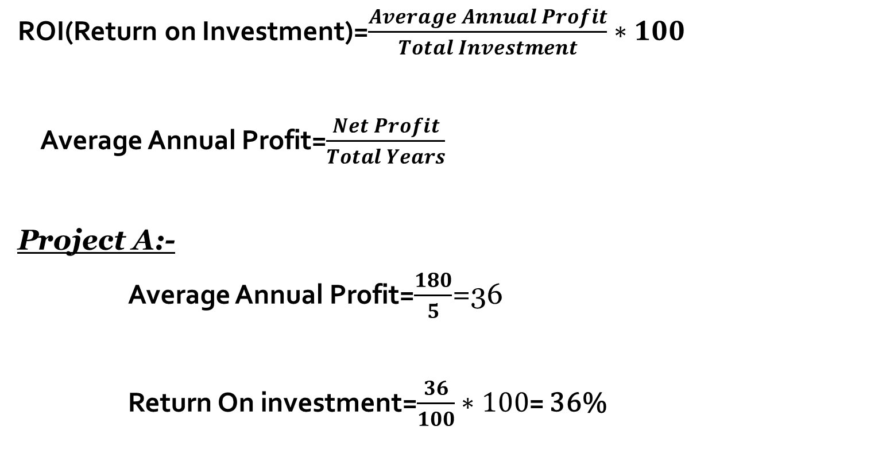
ROI(Return on Investment)=$\frac{Average Annual Profit}{Total Investment}∗100$
Average Annual Profit=$\frac{Net Profit}{Total Years}$
Project A:-
Average Annual Profit=$\frac{180}{5}$=36
Return On investment=$\frac{36}{100}∗100$= 36%

Slide 9

Payback Period=4 - $\frac{60}{70}$= 3$\frac{1}{7}$Year
$\frac{1}{7}∗12=\frac{12}{7}$=1$\frac{5}{7}$
$\frac{5}{7}$*30=$\frac{150}{7}$=21$\frac{3}{7}$
Payback Period= 3 Years 1 Month 21 Days

Slide 10
Which of these project will be chosen on the basis of a) Payback Period b)ROI(Return On Investment) c)NPV Assuming 10% discount rate
Years | Project A Cash flows | Project B Cash flows
0 | -100000 | -120000
1 | 10000 | 30000
2 | 10000 | 30000
3 | 10000 | 30000
4 | 20000 | 30000
5 | 100000 | 75000

Slide 11
Year | Project A |  |  |  | Project B
 | Cash Flows | Payback | D.F (10%) | Present Value | Cash Flows | Payback | D.F (10%) | Present Value
0 | -100000 | -100000 | 1 | -100000 | -120000 | -120000 | 1 | -120000
1 | 10000 | -90000 | 0.9091 | 9091 | 30000 | -90000 | 0.9091 | 27273
2 | 10000 | -80000 | 0.8264 | 8264 | 30000 | -60000 | 0.8264 | 24792
3 | 10000 | -70000 | 0.7513 | 7513 | 30000 | -30000 | 0.7513 | 22539
4 | 20000 | -50000 | 0.6830 | 13660 | 30000 | 0 | 0.6830 | 20490
5 | 100000 | 50000 | 0.6209 | 62090 | 75000 | 75000 | 0.6209 | 46567.5
 | NP=50000 |  |  | NPV=618 | NP=75000 |  |  | NPV=21661.5

Slide 12
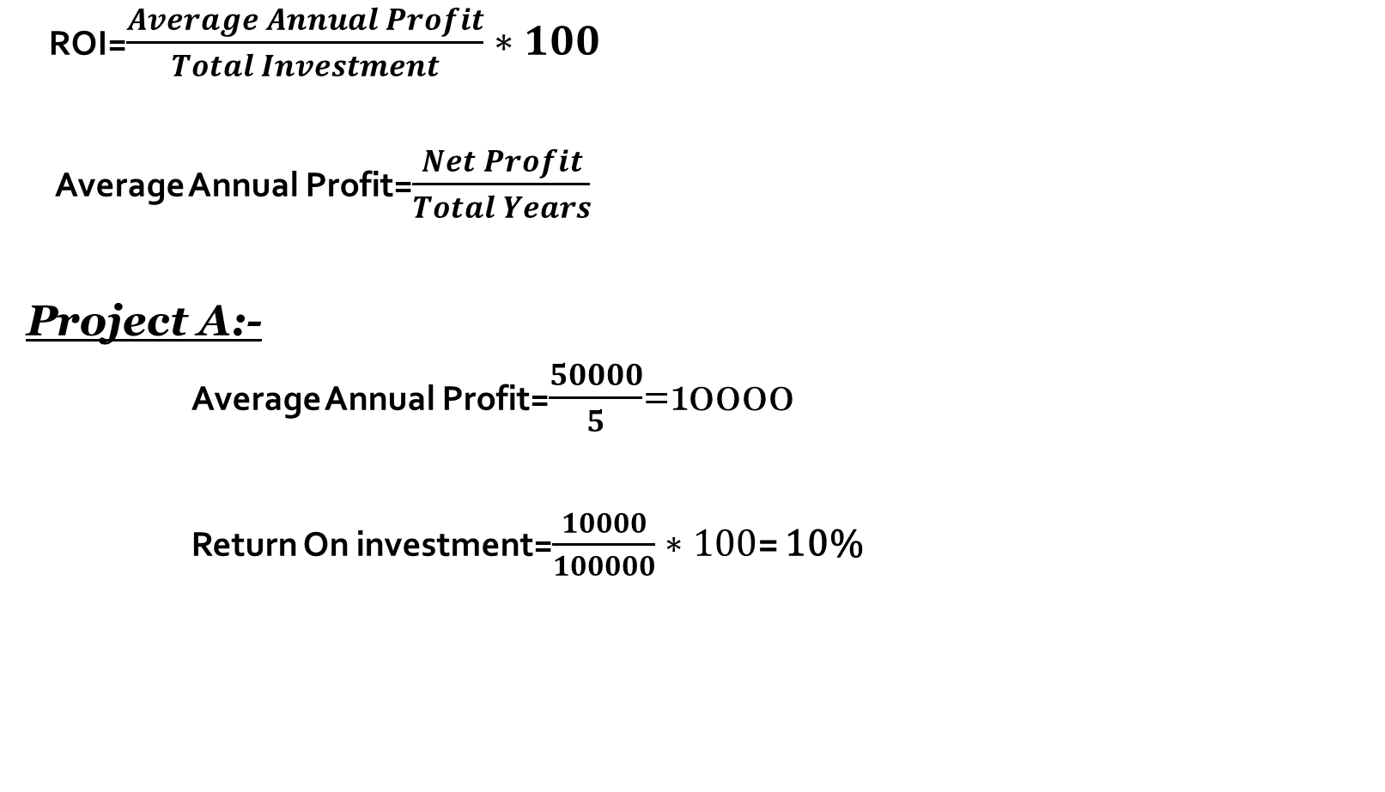
ROI=$\frac{Average Annual Profit}{Total Investment}∗100$
Average Annual Profit=$\frac{Net Profit}{Total Years}$
Project A:-
Average Annual Profit=$\frac{50000}{5}$=10000
Return On investment=$\frac{10000}{100000}∗100$= 10%

Slide 13

Payback Period=5 - $\frac{50000}{100000}$= 4$\frac{1}{2}$Year
$\frac{1}{2}∗12=$6
Payback Period= 4 Years 6 Months
Project B:-
Average Annual Profit=$\frac{75000}{5}$=15000
Return On Investment=$\frac{15000}{120000}∗100$= 12.5%

Slide 14

Payback Period=4- $\frac{0}{30000}$= 4 Years

